Slide 1

Credit Card Default Risk
Data Mining and Predictive Analytics
Di-Heng Liu
Drew-Elliot Ramsingh

Slide 2

Introduction
Credit cards are usually issued by banks, corporations and financial institutions so that clients can purchase goods and services on their credit.

Slide 3

Taiwanese Credit Card Market
Since 1974, Taiwanese credit card market issued the first credit card, the credit card's history has been developed more than 40 years. Now, credit cards have become part of people’s daily lives.

Slide 4
Definition of Each Attribute
X01 | Amount of the given credit | X13 | Amount of bill statement in Aug. 2005
X02 | Gender | X14 | Amount of bill statement in Jul. 2005
X03 | Education | X15 | Amount of bill statement in Jun. 2005
X04 | Marital status | X16 | Amount of bill statement in May 2005
X05 | Age | X17 | Amount of bill statement in Apr. 2005
X06 | Repayment status in Sep. 2005 | X18 | Amount paid in Sep. 2005
X07 | Repayment status in Aug. 2005 | X19 | Amount paid in Aug. 2005
X08 | Repayment status in Jul. 2005 | X20 | Amount paid in Jul. 2005
X09 | Repayment status in Jun. 2005 | X21 | Amount paid in Jun. 2005
X10 | Repayment status in May 2005 | X22 | Amount paid in May 2005
X11 | Repayment status in Apr. 2005 | X23 | Amount paid in Apr. 2005
X12 | Amount of bill statement in Sep. 2005 | Target | Default or None
In the third quarter of 2005, many Taiwanese credit cardholders began to default on payments due to the high interest rates. Meanwhile, credit business was considered by banks and finance companies as the fastest way to make profit, so they continued to issue credit cards. Therefore, more and more people fell into the credit card debt crisis.

Slide 5
Tests of Significance (F-value, p-value)
Attributes | F-Values | p-Value
X01 | 724.068539 | 1.30E-157
X02 | 47.9788543 | 4.40E-12
X03 | 23.5471118 | 1.23E-06
X04 | 17.7812714 | 2.49E-05
X05 | 5.78855582 | 1.61E-02
X06 | 3537.71497 | 0.00E+00
X07 | 2239.16914 | 0.00E+00
X08 | 1757.46644 | 0.00E+00
X09 | 1476.84597 | 1.89929659e-315
X10 | 1304.59118 | 1.13E-279
X11 | 1085.40249 | 7.30E-234
X12 | 11.5805315 | 6.67E-04
X13 | 6.04423789 | 1.40E-02
X14 | 5.94438771 | 1.48E-02
X15 | 3.09474518 | 7.86E-02
X16 | 1.3710874 | 2.42E-01
X17 | 0.865820292 | 3.52E-01
X18 | 160.40381 | 1.15E-36
X19 | 103.291524 | 3.17E-24
X20 | 95.2180109 | 1.84E-22
X21 | 97.1880005 | 6.83E-23
X22 | 91.4298008 | 1.24E-21
X23 | 85.0890453 | 3.03E-20
cardholder’s repayment status in the month of September 2005 (X6) returned the highest F-value and lowest p-value
cardholder’s balance in April 2005 (X17) returned the lowest F-value and highest p-value
the result of a random forest classifier was also used to decide the removal of features before use in models

Slide 6
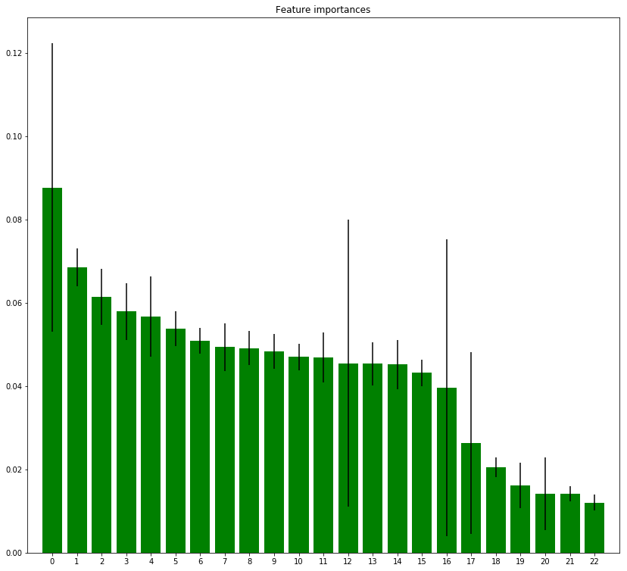
Feature Selection
1. X 6 (0.087710)
2. X 5 (0.068534)
3. X 12 (0.061375)
4. X 1 (0.057906)
5. X 18 (0.056705)
6. X 13 (0.053722)
7. X 15 (0.050880)
8. X 14 (0.049404)
9. X 17 (0.049131)
10. X 16 (0.048376)
11. X 19 (0.047038)
12. X 23 (0.046927)
13. X 7 (0.045477)
14. X 20 (0.045347)
15. X 22 (0.045226)
16. X 21 (0.043170)
17. X 8 (0.039622)
18. X 10 (0.026367)
19. X 3 (0.020520)
20. X 11 (0.016189)
21. X 9 (0.014193)
22. X 4 (0.014138)
23. X 2 (0.012043)

Slide 7
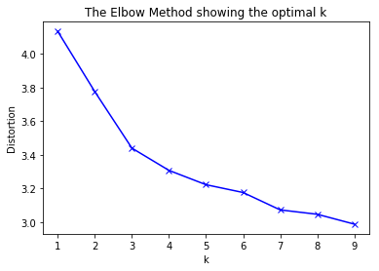
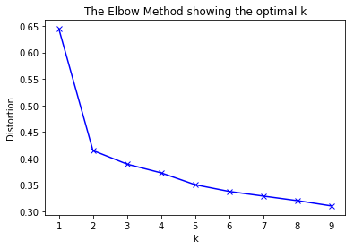
Elbow method (Clustering)
The percentage of variance explained by the clusters against the number of clusters, the first clusters is going to add much information, then at some point the line in the plot will drop, and then an angle in the graph will be given. The number of clusters will be chosen at this point called the "elbow", but the "elbow" cannot always be identified.

Slide 8
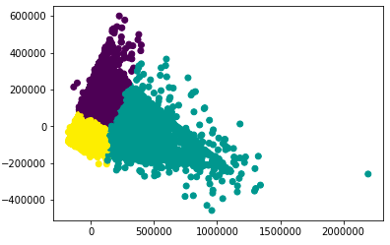
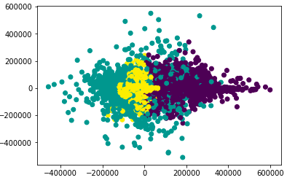
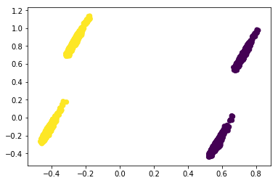
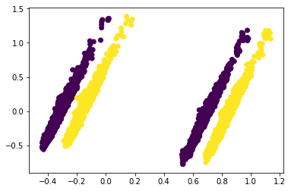
K-means and PCA
From k-means clustering and principal component analysis, using the scaled dataset works better for segmenting the observations into more distinguishable clusters, that is, “default” and “non-default” groups.

Slide 9
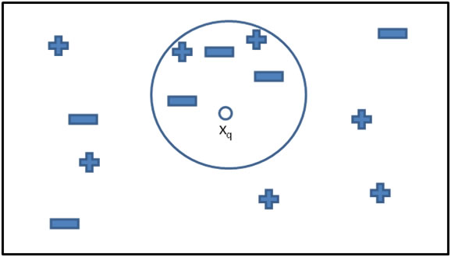
K Nearest Neighbors (KNN)
The main concept of KNN is quite intuitive as each observation that is a coordinate position in a multi-dimensional space, which means all data are coordinates.
Neighbors: 29

Slide 10
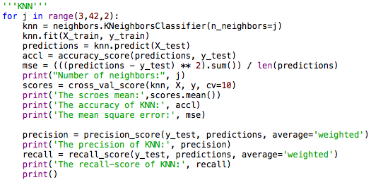
KNN Codes and Results
Scores Mean: 0.8123
Accuracy: 0.8105
Mean Square Error: 0.1849
Precision: 0.7893
Recall-score: 0.8105

Slide 11
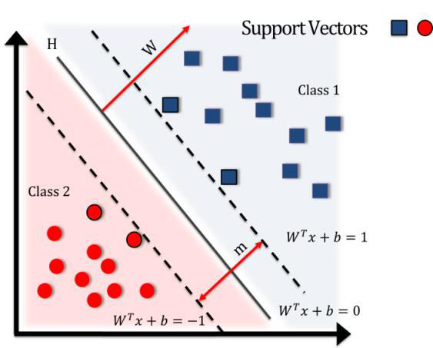
Support Vector Machines (SVM)
SVM is a method used only for supervised learning, which means it needs to be trained in advance to generate a model. Its basic concept is in the two-dimensional space, there must be a hyperplane that can clearly separate the two categories.
Kernel: rbf
The Radial Basis Function, 'rbf', is a popular kernel function used in various kernelized learning algorithms, which is commonly used in SVM classification, and it can be effective in the high dimensional space.

Slide 12
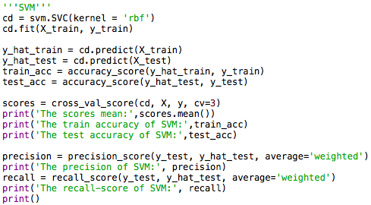
SVM Codes and Results
Scores Mean: 0.7866
Train Accuracy: 0.7806
Test Accuracy: 0.7851
Precision: 0.7898
Recall-score: 0.7851

Slide 13
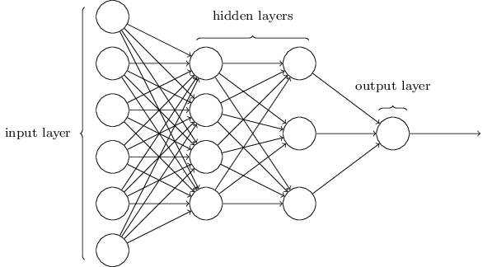
Neural Network
solver: lbfgs
hidden layer size: 10
activation: logistic
The default solver 'adam' works pretty well on relatively large datasets in terms of both training time and validation score and refers to a stochastic gradient-based optimizer proposed. However ’lbfgs’ gave us the better result, so we switch to it. The activation function is for the hidden layer. The logistic sigmoid function: returns f(x) = 1 / (1 + exp(-x))

Slide 14
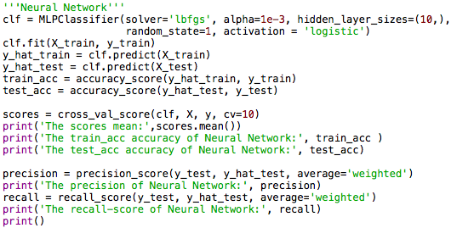
Neural Network Codes and Results
Scores Mean: 0.8202
Train Accuracy: 0.8207
Test Accuracy: 0.8202
Precision: 0.8028
Recall-score: 0.8202

Slide 15
Results and Summary
 | K nearest neighbors | Support Vector Machines | Neural Network
Cross Val Mean | 0.8123 | 0.7866 | 0.8202
Accuracy (Test) | 0.8105 | 0.7851 | 0.8202
Precision | 0.7893 | 0.7898 | 0.8028
Recall | 0.8105 | 0.7851 | 0.8202
Based on the results we got from our algorithms, the best cross validation score, accuracy, and precision were with Neural Network. It is the best model for this data set.
Notes:
Accuracy = (TP+TN)/(TP+FP+FN+TN)
Precision = P=TP/(TP+FP)
Recall = TP/(TP+FN)

Slide 16

Conclusion
For clients who have a higher percentage to default (classified to default) through our algorithm, we can alert credit card issuers to take measures to mitigate loss from the defaults.

